Slide 1
Insertion Sort

Slide 2
How does it work?
Essentially the same way you order anything in day_to _day life.
Cards
Straws
Arrays?

Slide 3
Example

Slide 4
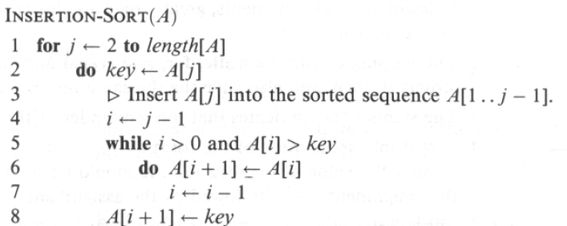
Algorithm

Slide 5
Running Time
Best Case: O(n).
Worst Case: O(n^2), if given in reverse order.
Average Case: O(n^2), still a quadratic running time.

Slide 6
Best Times to Use Insertion Sort
When the data sets are relatively small.
Moderately efficient.
When you want a quick easy implementation.
Not hard to code Insertion sort.
When data sets are mostly sorted already.
(1,2,4,6,3,2)

Slide 7
Worst Times to Use Insertion Sort
When the data sets are relatively large.
Because the running time is quadratic
When data sets are completely unsorted
Absolute worst case would be reverse ordered. (9,8,7,6,5,4)

Slide 8
Insertion Sort Works in Place
No extra data structures needed. It works on original data structure that it is fed with and simply swaps the position of the items in the set.
It does not require any extra memory as data sets get larger. Will always require the same amount of memory.

Slide 9
Calculating the address of any element In the 1-D array:
To find the address of an element in an array the following formula is used-
Address of A[I] = B + W * (I – LB)
I = Subset of element whose address to be found,
B = Base address,
W = Storage size of one element store in any array(in byte),
LB = Lower Limit/Lower Bound of subscript(If not specified assume zero).

Slide 10
Example: Given the base address of an array A[1300 ………… 1900] as 1020 and the size of each element is 2 bytes in the memory, find the address of A[1700].
Solution:
Base address B = 1020
Lower Limit/Lower Bound of subscript LB = 1300
Storage size of one element store in any array W = 2 Byte
Subset of element whose address to be found I = 1700
Formula used:
Address of A[I] = B + W * (I – LB)
Solution:
Address of A[1700] = 1020 + 2 * (1700 – 1300)
= 1020 + 2 * (400)
= 1020 + 800
Address of A[1700] = 1820

Slide 11
Calculate the address of any element in the 2-D array:
The 2-dimensional array can be defined as an array of arrays. The 2-Dimensional arrays are organized as matrices which can be represented as the collection of rows and columns as array[M][N] where M is the number of rows and N is the number of columns.
To find the address of any element in a 2-Dimensional array there are the following two ways-
Row Major Order
Column Major Order

Slide 12
1. Row Major Order:
Row major ordering assigns successive elements, moving across the rows and then down the next row, to successive memory locations. In simple language, the elements of an array are stored in a Row-Wise fashion. To find the address of the element using row-major order uses the following formula:
Address of A[I][J] = B + W * ((I – LR) * N + (J – LC))
I = Row Subset of an element whose address to be found, J = Column Subset of an element whose address to be found, B = Base address, W = Storage size of one element store in an array(in byte), LR = Lower Limit of row/start row index of the matrix(If not given assume it as 0), LC = Lower Limit of column/start column index of the matrix(If not given assume 0), N = Number of column given in the matrix.

Slide 13
Example: Given an array, arr[1………10][1………15] with base value 100 and the size of each element is 1 Byte in memory. Find the address of arr[8][6] with the help of row-major order.
Given:
Base address B = 100
Storage size of one element store in any array W = 1 Bytes
Row Subset of an element whose address to be found I = 8
Column Subset of an element whose address to be found J = 6
Lower Limit of row/start row index of matrix LR = 1
Lower Limit of column/start column index of matrix LC= 1
Number of column given in the matrix N = Upper Bound – Lower Bound + 1
= 15 – 1 + 1
= 15
Address of A[I][J] = B + W * ((I – LR) * N + (J – LC))
Address of A[8][6] = 100 + 1 * ((8 – 1) * 15 + (6 – 1))
= 100 + 1 * ((7) * 15 + (5))
= 100 + 1 * (110)
Address of A[I][J] = 210

Slide 14
2. Column Major Order: If elements of an array are stored in a column-major fashion means moving across the column and then to the next column then it’s in column-major order. To find the address of the element using column-major order use the following formula:
Address of A[I][J] = B + W * ((J – LC) * M + (I – LR))
I = Row Subset of an element whose address to be found, J = Column Subset of an element whose address to be found, B = Base address, W = Storage size of one element store in any array(in byte), LR = Lower Limit of row/start row index of matrix(If not given assume it as zero), LC = Lower Limit of column/start column index of matrix(If not given assume it as zero), M = Number of rows given in the matrix.

Slide 15
Example: Given an array arr[1………10][1………15] with a base value of 100 and the size of each element is 1 Byte in memory find the address of arr[8][6] with the help of column-major order.
Base address B = 100
Storage size of one element store in any array W = 1 Bytes
Row Subset of an element whose address to be found I = 8
Column Subset of an element whose address to be found J = 6
Lower Limit of row/start row index of matrix LR = 1
Lower Limit of column/start column index of matrix = 1
Number of column given in the matrix M = Upper Bound – Lower Bound + 1
= 10 – 1 + 1
= 10
Address of A[I][J] = B + W * ((J – LC) * M + (I – LR))
Address of A[8][6] = 100 + 1 * ((6 – 1) * 10 + (8 – 1))
= 100 + 1 * ((5) * 10 + (7))
= 100 + 1 * (57)
Address of A[I][J] = 157

